Slide 1
Analyzing Foodborne Disease Outbreaks Over Time
A look into illnesses and more
Notes:
[Kenneth]

Slide 2
Group 12
Trina Shores (group leader)
Steven Macapagal
Journey Martinez
Yuan Yao
Heather Nagy
Kenneth Porter
Notes:
[everyone] - introduce yourself and your degree

Slide 3
Summary of prior findings
Notes:
[Journey] slides 3-11

Slide 4
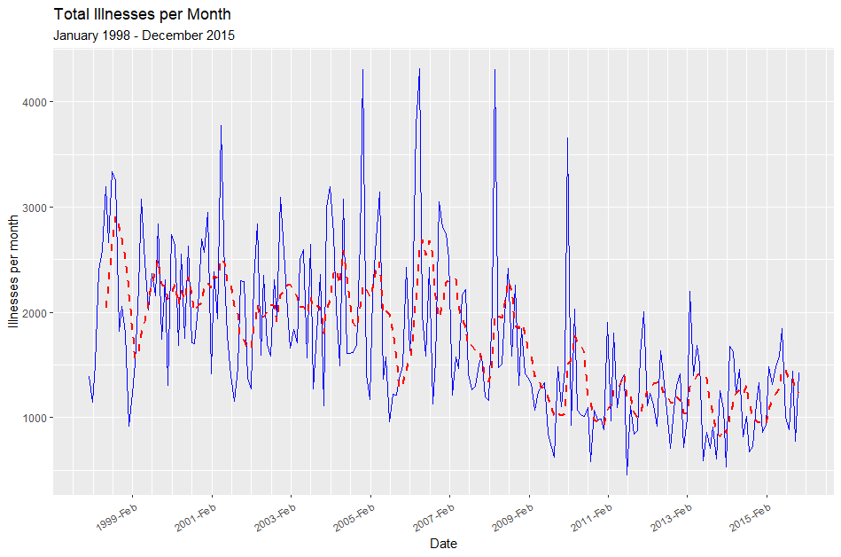
A reminder of what our data look like
Solid blue line represents the original time series
Dotted red line represents a filtered time series over a 6-month period
Notes:
[Journey] slides 3-11
There is quite a bit of variability in the illness counts leading up to 2010, at which point it becomes more consistent. Although it’s messy at first, we also saw a downward trend and maybe some seasonality. We needed to address the nonconstant variance and trend immediately, so we took a log transformation of the data and then differenced to reach stationarity.

Slide 5
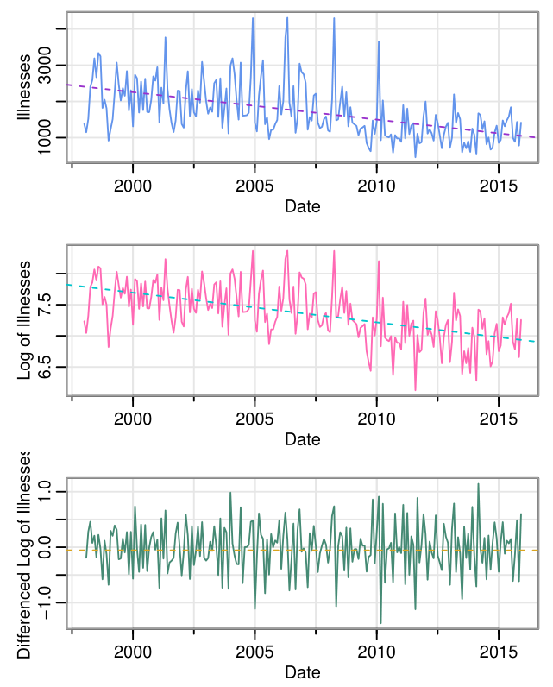
Stationarity
Variability is much greater from 1998 to 2010 and decreases from 2011 to 2015. Illnesses also seem to be trending downward and might be seasonal.
Log transforming and differencing achieved a more constant variance and got rid of the trend, giving us stationary data to work with.
Notes:
[Journey] slides 3-11
There is quite a bit of variability in the illness counts leading up to 2010, at which point it becomes more consistent. Although it’s messy at first, we also saw a downward trend and maybe some seasonality. We needed to address the nonconstant variance and trend immediately, so we took a log transformation of the data and then differenced to reach stationarity.

Slide 6
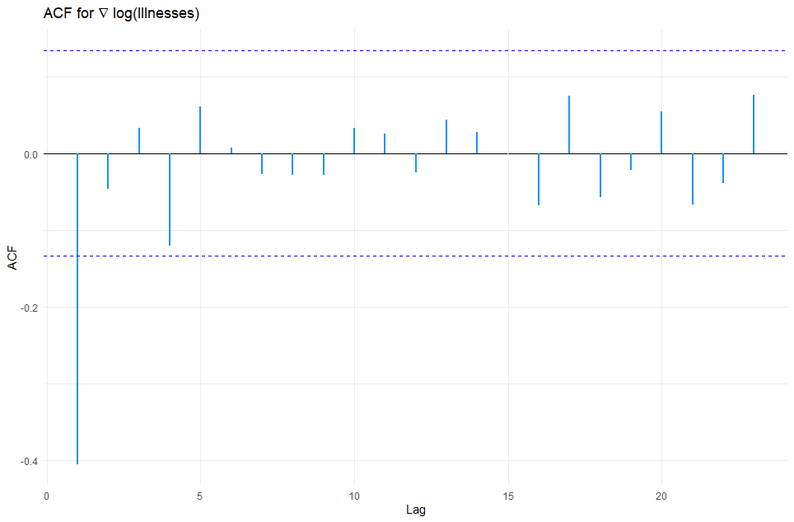
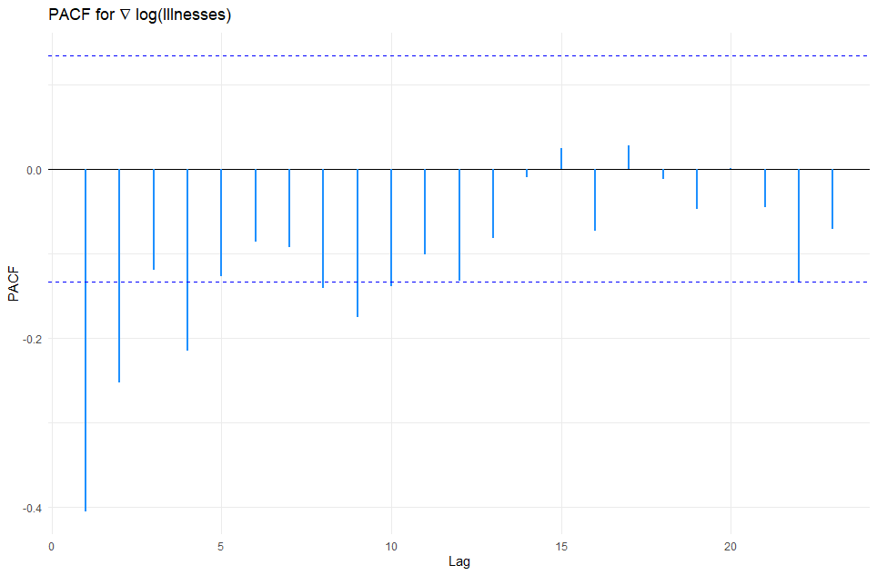
ACF and PACF
Only the first lag appears to be significant, while the ACF is not significantly different from zero afterwards.
The partial autocorrelogram appears to tail off over time. The first few lags are significant, and the magnitude of PACF decreases over time.
Notes:
[Journey] slides 3-11
To begin forming our model, we first considered the correlograms of our data. The ACF shows that only the first lag is significant with the rest immediately dropping below the significance threshold. The PACF, though, has several significant lags trailing off until finally below the threshold. This is characteristic behavior of a moving average order 1 mode, or MA(1).

Slide 7
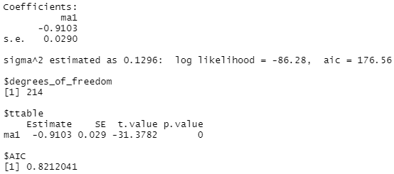
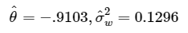
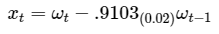
Parameter Estimation of MA(1)
MLE estimation (unconditional least squares) with the sarima function in the astsa library
Using p = 0, d= 1 (using log data) and q = 1 yielded best results
Values converged = > reasonable model
Conditional SS = -1.010483
Unconditional SS = -1.017639
MA(1) term significant
Notes:
[Journey] slides 3-11
We used the sarima function from the astsa package in R to fit the MA(1) model to our data. Our sums of squares converged and the estimates were significant, yielding a model of
xt=wt-0.9103wt-1, with a variance of 0.1296.

Slide 8
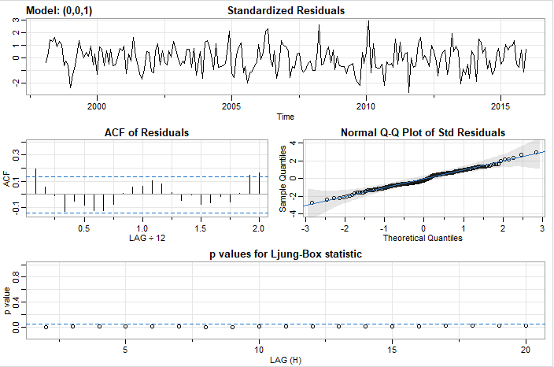
Estimation Output of MA(1)
Scattered, Normally distributed residuals
ACF shows no departure from model assumptions
p-values for Q tests are all less than 0.05
Residuals are correlated!
Notes:
[Journey] slides 3-11
Checking the diagnostics of the model, we found that the residuals had decently constant variance and followed a normal distribution. However, the Q tests showed correlation amongst them. This meant the residuals couldn’t be white noise, and the model was invalid.

Slide 9
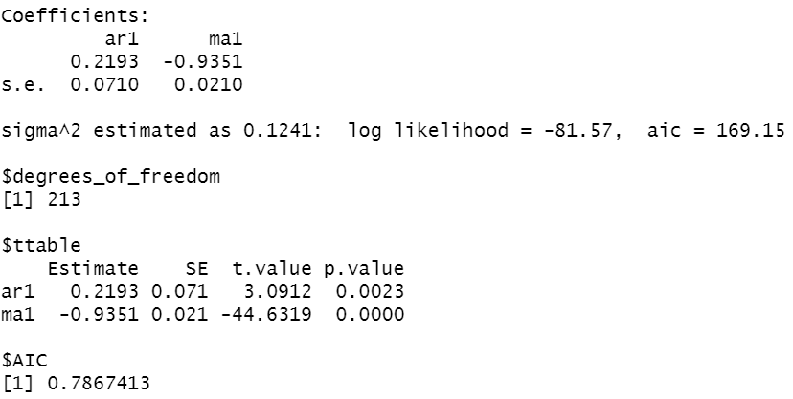
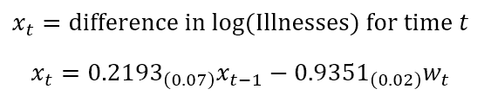
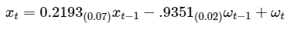
Parameter estimation of ARIMA(1,1,1)
MLE estimation (unconditional least squares) with the sarima function in the astsa library
Using p = 1, d= 1 (using log data) and q = 1 yielded best results
Values converged = > reasonable model
Conditional SS = -1.014162
Unconditional SS = -1.039521
AR(1) and MA(1) terms significant
Smaller AIC and BIC than AR(1) and MA(1) models
Notes:
[Journey] slides 3-11
To remove the remaining correlation, we chose to add an AR(1) term to the model, creating an ARIMA(1,1,1). As before, the sarima function results showed converging sums of squares and significant model terms. The estimates provided specified the model to be
xt=0.2193xt-1-0.9351wt-1+wt
Even the BIC was lower for this model, despite it having more parameters, proving it to be an improvement.

Slide 10
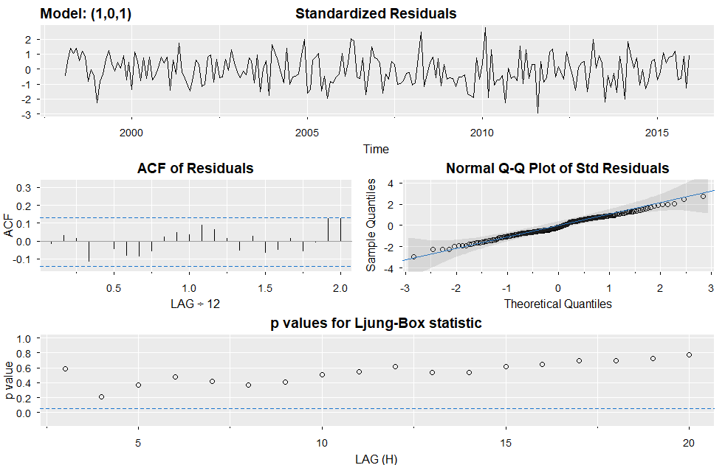
Estimation Output of ARIMA(1,1,1)
Scattered, Normally distributed residuals
ACF shows no departure from model assumptions
p-values for Q tests all greater than 0.05
Residuals are uncorrelated
Notes:
[Journey] slides 3-11
Checking the diagnostics showed promising signs of white noise: the residuals had constant variance, followed a normal distribution, and both the ACF and Q tests showed they were no longer correlated. Thus, we had found a valid model.

Slide 11
Our plan
Compare subsets of the data to see if there is an underlying pattern to foodborne disease outbreaks.
Compare models of foodborne illness to models of hospitalizations related to foodborne illness.
Compare different models to our previously established ARIMA(1, 1, 1) model on fit characteristics and prediction.
Notes:
[Journey] slides 3-11
To further our study, we planned to analyze a large subset of the data based on source of illness, to remove some variability and hopefully display more of the behaviors in the data. We were also interested in the effect that illness counts had on total hospitalizations. Lastly, we hoped to use this newfound knowledge to develop other valid models for comparison to our ARIMA(1,1,1).

Slide 12
Analyzing source of outbreaks
Notes:
[Steven] slides 12-24
For our first goal, we wanted to see if each type of illness source accounted for the variability in our data. We’ll present salmonella as a specific case, but most of the sources we examined displayed similar behavior.

Slide 13
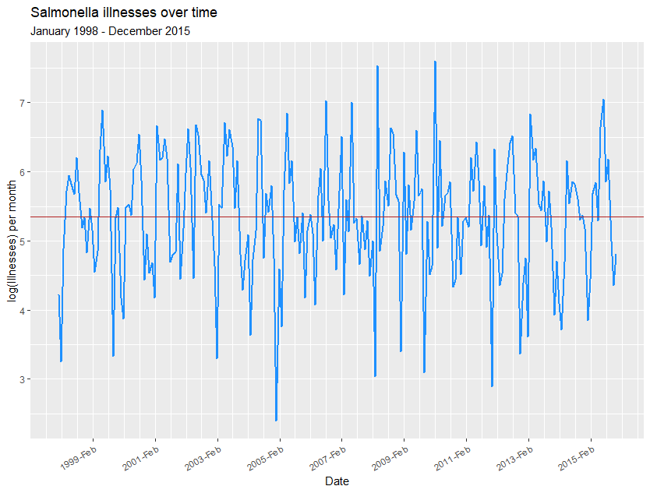
Analysis of salmonella cases
Plot of log(illnesses) for salmonella cases appears to be stationary
Seems to have a seasonal component
Notes:
We grouped the data by specific sources of illness, and plotted the series. The only transformations needed were a log transformation; differencing did not appear to help. Already, the data appear to show a seasonal component.

Slide 14
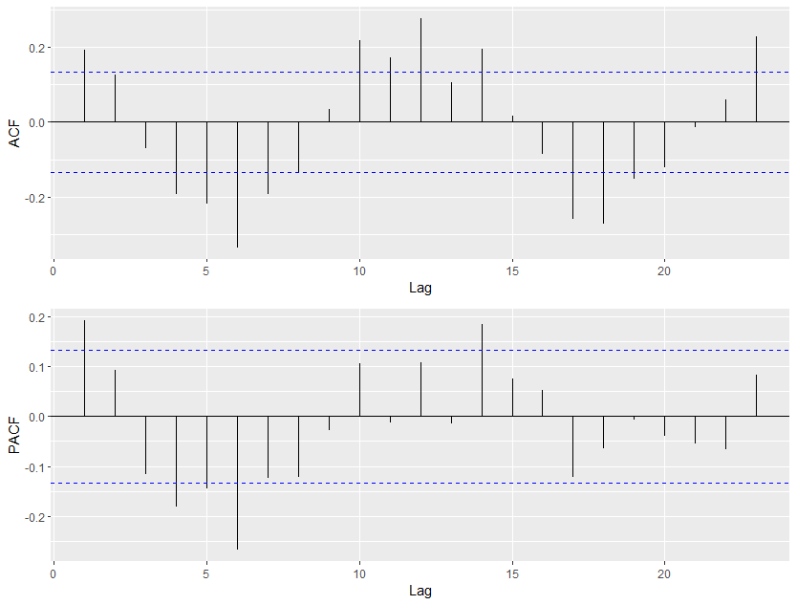
Analysis of salmonella cases
Seasonal differencing needed: ACF is large and significant for every 12th lag, seems to tail off slowly
ACF and PACF have significant 1st lags
Notes:
The seasonality can be seen in the ACF and PACF plots; every 12th lag appears to be significant. Because the ACF is large for every 12th lag, we’ll do a seasonal AR difference. The seasonal PACF is only significant for the 12th lag, so we’ll use that to determine the seasonal order. Note also the 1st regular lags for ACF and PACF are significant.

Slide 15
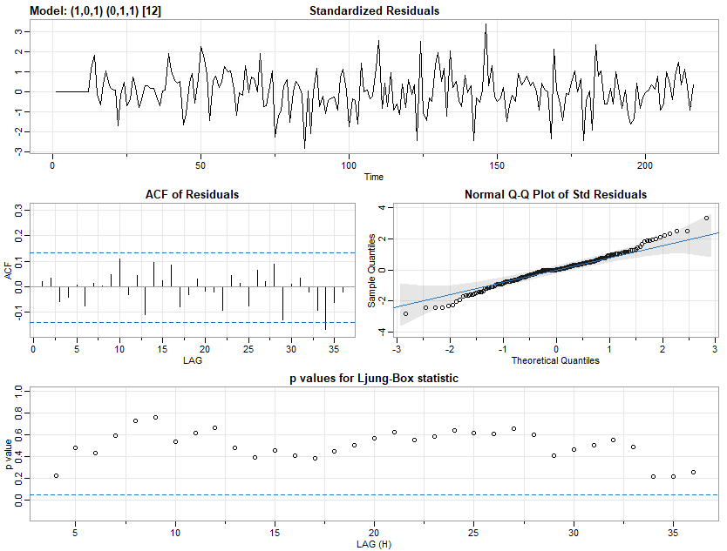
Analysis of salmonella cases
SARIMA(1, 0, 1) x (0, 1, 1)₁₂
Residuals appear to be normally distributed white noise
P-values for Ljung-Box statistic appear to be nonsignificant
Notes:
Therefore, we’ll fit an ARIMA(1, 0, 1) with yearly seasonal component (0, 1, 1). The diagnostics appear to show a good fit - the residuals are normally distributed whtie noise, and the p-values for the Q-statistic are all non significant, so this model appears to be a good fit.

Slide 16
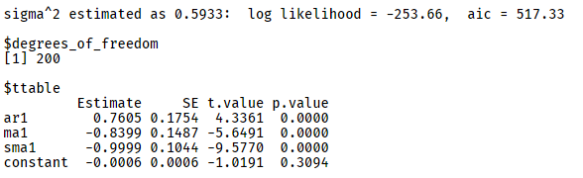
Analysis of salmonella cases
SARIMA(1, 0, 1) x (0, 1, 1)₁₂
Estimated coefficients:
∅₁ = 0.76
θ₁ = -0.84
Θ₁ = -1
σ² = 0.59, df =200
Notes:
When we estimated the coefficients, all terms appeared to be significant and a constant was not needed.

Slide 17
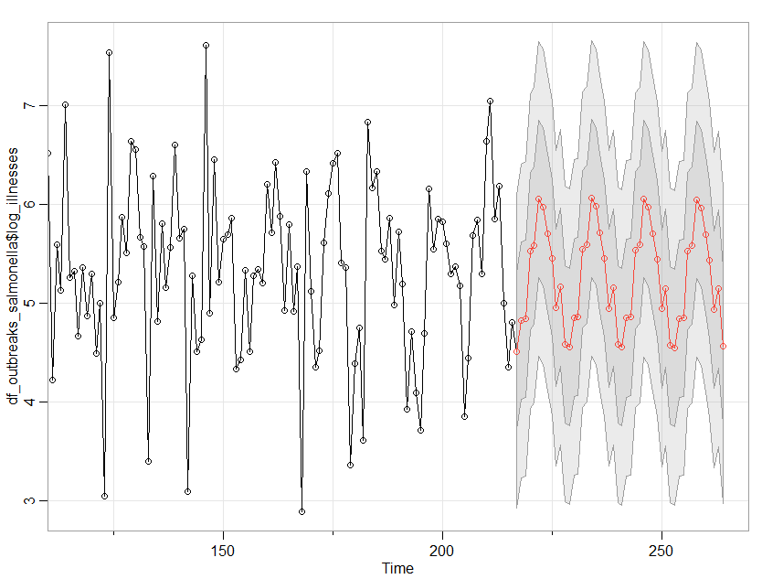
Analysis of salmonella cases
Seasonal forecasts of log(salmonella)
Notes:
We also saw that a seasonal forecast seemed to match the cyclic nature and variance seen in the past.

Slide 18
Relationships between
illnesses and hospitalizations
Notes:
Next, one of our original goals was to compare illnesses and hospitalizations.

Slide 19
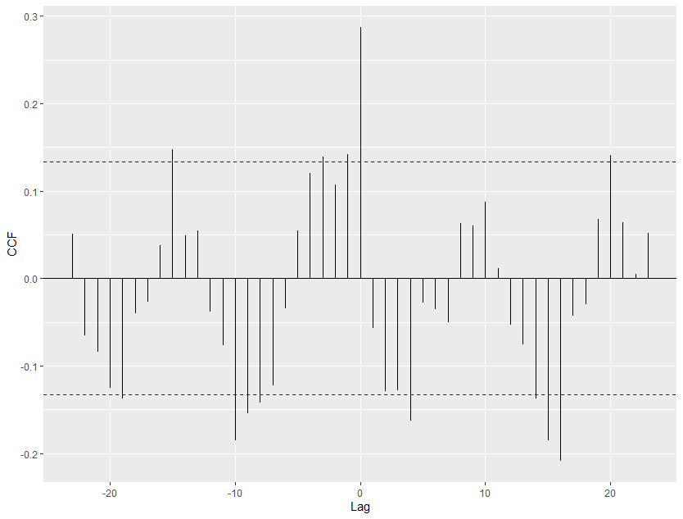
CCF of overall illnesses and hospitalizations
Strongest cross-correlation between illnesses and hospitalizations in the same period
Appears to have some seasonality
Notes:
To accomplish this, we computed the cross-correlation between log_illnesses and log_hospitalizations and found the strongest cross-correlations to be in the same period. The seasonality present in the original data is suggested in the CCF as well.

Slide 20
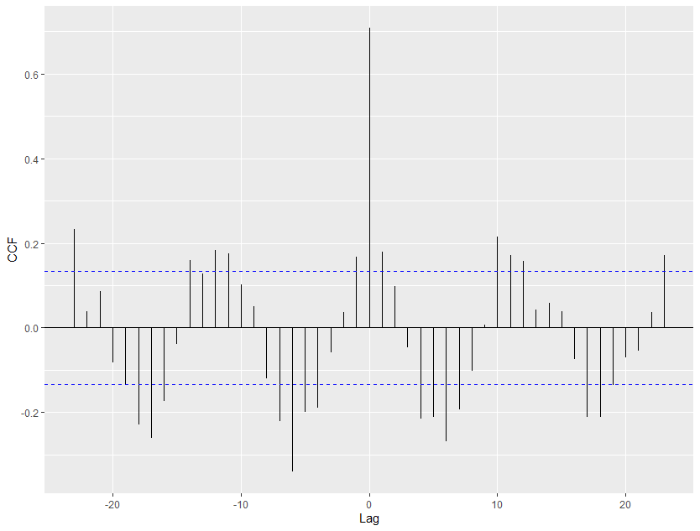
Analysis of salmonella cases
CCF of log(illnesses) and log(hospitalizations)
Seasonal patterns of illness still apparent
Strongest cross-correlations in same period (hospitalizations follow a diagnosed illness closely)
Notes:
When we look at the salmonella cases only, the patterns we saw in the previous plot seem to be much stronger. For lag 0, the most likely explanation for this pattern is that hospitals have a consistent reporting mechanism of foodborne illnesses to the CDC, whereas cases diagnosed outside a hospital may not be reported consistently.

Slide 21
Comparisons to
baseline ARIMA(1, 1, 1) model
Notes:
Our main goal was to build on our ARIMA(1, 1, 1) model from the last round and see which one performed the best.

Slide 22
Steps
Modeling process:
Model formulation
Model estimation
Model diagnostics
Model selection
We will also compare their forecasts to the actual data released for 2016 through 2019.
Models:
ARIMA(1, 1, 1) [baseline]
ARIMA(1, 1, 0) [Li et al. (2021)]
ARIMA(1, 1, 1) + GARCH(1, 0)
ARIMA(1, 1, 1) x (1, 0, 1)₁₂
ARIMA(1, 1, 1) x (0, 1, 1)₁₂
Prophet (examined later)
Notes:
To accomplish this, we used steps similar to what we did in class. We will construct six different models and compare their fit and forecasts.

Slide 23
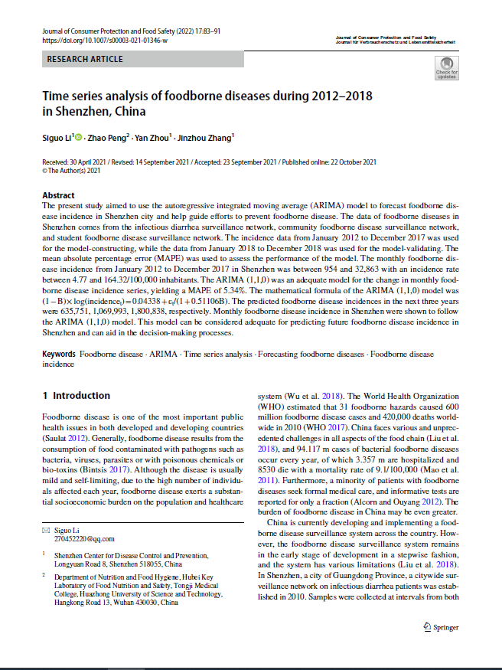
Comparing models suggested in prior literature
Li, et al. (2021) suggested an ARIMA(1, 1, 0) model to describe the incidence of foodborne illnesses over time.
Performance and prediction compared to ARIMA(1, 1, 1) model we had previously found to fit our data
Li, S., Peng, Z., Zhou, Y., & Zhang, J. (2021). Time series analysis of foodborne diseases during 2012-2018 in Shenzhen, China. Journal of Consumer Protection and Food Safety, 17(2), 83-91.
Notes:
Our first model was inspired by some prior literature we had read about foodborne illness modeling. The authors in this article took similar data and fit an ARIMA(1, 1, 0) model, so we will try to replicate that and see if it works with our data.

Slide 24
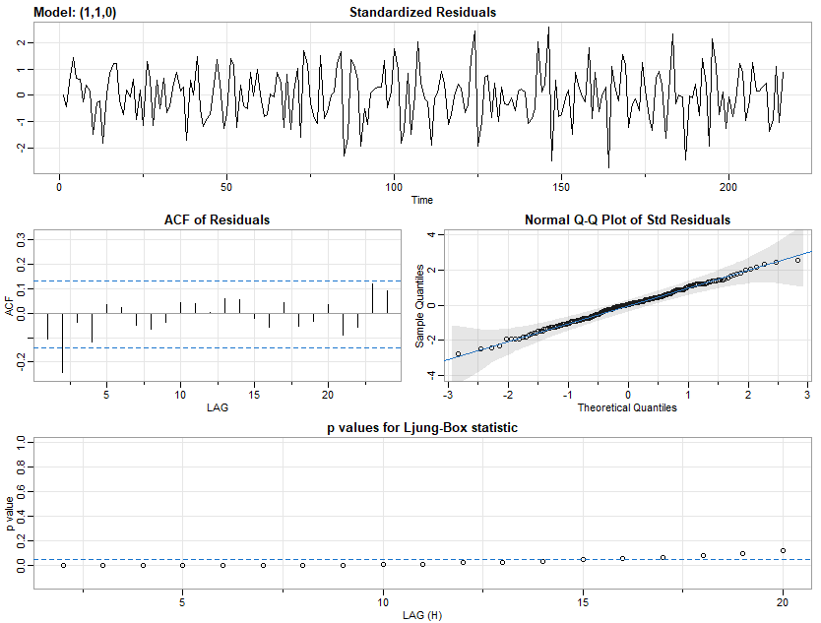
ARIMA(1, 1, 0) [Li et al., 2021]
Diagnostics show residuals are not white noise, still have some autocorrelation
Estimated coefficients: ∅₁ = -0.41 (0.06) σ² = 0.16, df = 214
AIC = 1.02 BIC = 1.05
Notes:
These diagnostics show a lack of fit to the data - we still have some autocorrelation left in the residuals, so our residuals cannot be described as white noise. This model is probably not a good fit for our data, despite it being a good fit for the article from Li.

Slide 25
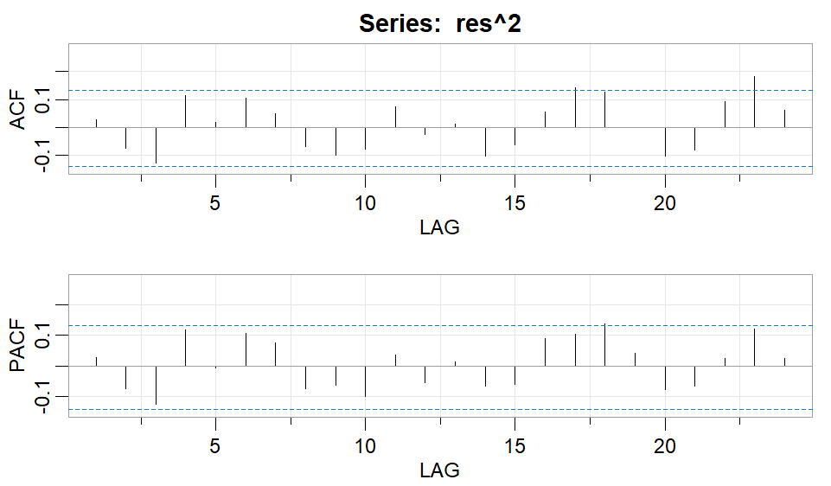
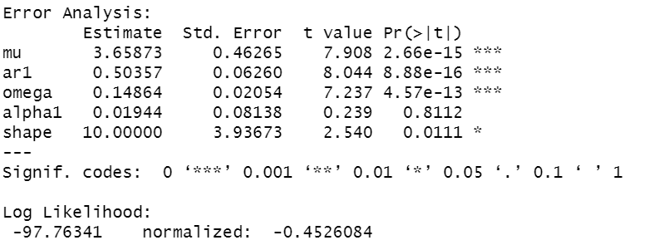
ARIMA(1,1,1) + GARCH(1,0)
Some small dependence left in ARIMA(1,1,1) squared residuals
Average of residuals = 0.012
ARIMA(1,1,1) + GARCH(1,0) on transformed data does not have significant alpha term
GARCH(1,0) not needed
Notes:
Squared residuals show some dependence compared to Figure 8.2 in textbook but not much
Slightly biased forecasts as mean is close to but not equal to 0
Sig alpha term 2-sided p value (0.0698) for unlogged data but AIC increased from 9.26 to 15.87
Didn’t find GARCH to be useful for leftover dependence in residuals

Slide 26
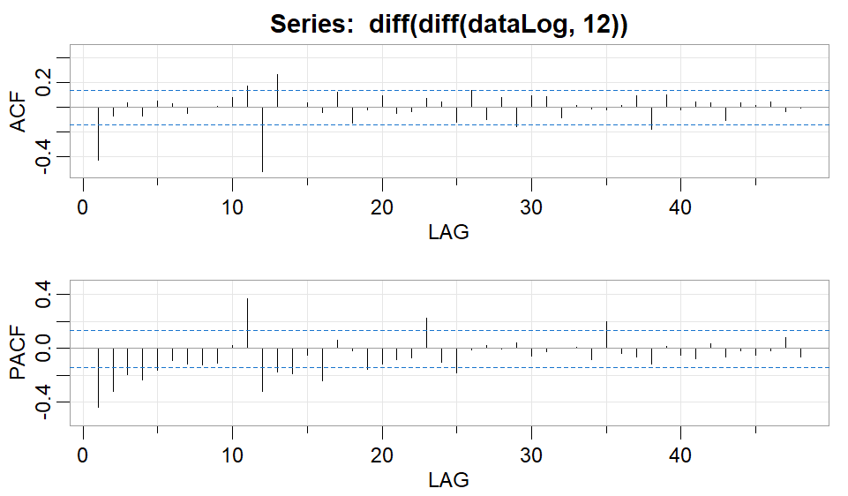
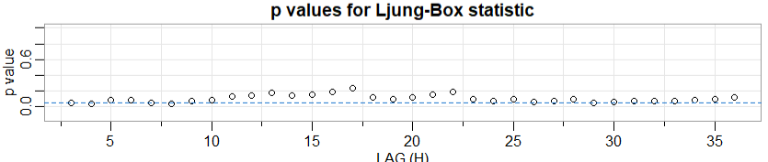
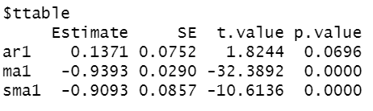
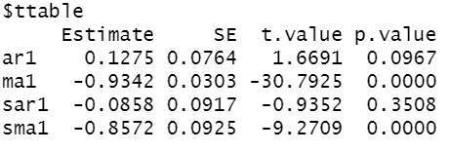
Seasonality
There appears to be a seasonal component
ACF cuts off at lag 12, PACF tails off
Try adding SMA1 term
ARIMA(1,1,1)x(0,1,1)₁₂ is possible
However, AR1 is not significant
ARIMA(0,1,1)x(0,1,1) did not have white noise residuals
ARIMA(1,1,1)x(1,1,1)₁₂
AR1 and SAR1 terms not significant

Slide 27
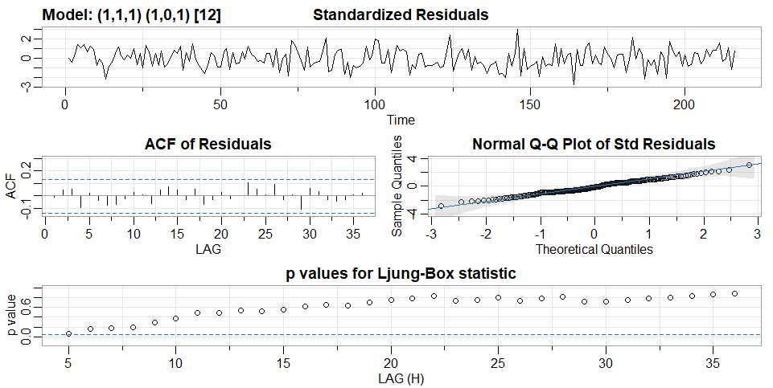
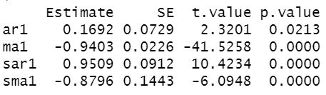
Selecting seasonal component
ARIMA(1,1,1)x(1,0,1)₁₂ has significant estimates
Slightly smaller AIC compared to ARIMA(1,1,1)
Residuals appear to be white noise
AIC = 0.769, BIC = 0.847
AIC =0.787 , BIC = 0.834 for baseline ARIMA
Notes:
Ran with undifferenced logged data, slight improvement over ARIMA(1,1,1)

Slide 28
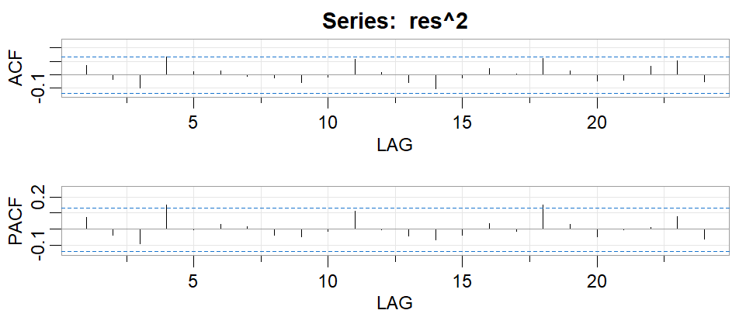
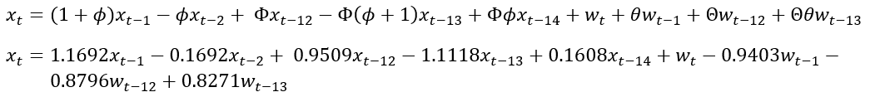
ARIMA(1,1,1) x (1,0,1)12
Less dependence in squared residuals compared to ARIMA(1,1,1)
Mean(residuals) = 0.006
Closer to zero than mean of ARIMA(1,1,1) residuals
Less biased forecast

Slide 29
Models/Forecasts comparison
Notes:
[Kenneth] slides 29-37

Slide 30
Model Comparisons
Model | AIC | BIC
ARIMA(1, 1, 1) | 0.787 | 0.834
ARIMA(1, 1, 0) | 1.020 | 1.051
ARIMA(1,1,1)x(1,0,1)₁₂ | 0.769 | 0.847
ARIMA(1,1,1)x(0,1,1)₁₂ | 0.881 | 0.946
ARIMA(1,1,1)-GARCH(1,0) | 0.926 | 0.989

Slide 31
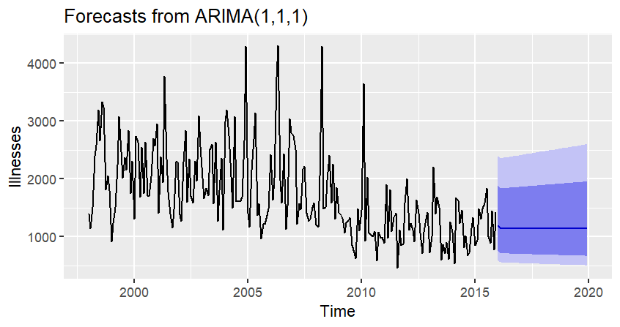
Forecast for ARIMA(1, 1, 1)
The model mean’s forecast appears to match mean of data
But it doesn’t appear to capture seasonal volatility well

Slide 32
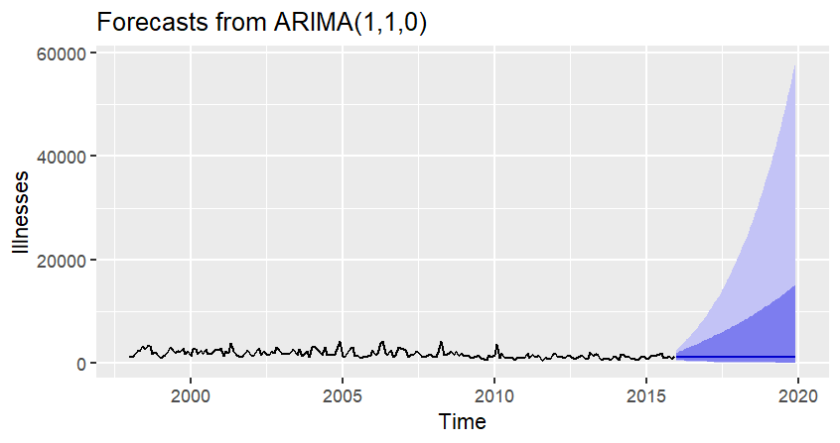
Forecast for ARIMA(1, 1, 0)
Clearly not an ideal forecast due to the high upper CI bound
However, the mean forecast appears to be accurate
Notes:
When the model doesn’t fit the data appropriately, the forecast variance seems to increase a faster rate

Slide 33
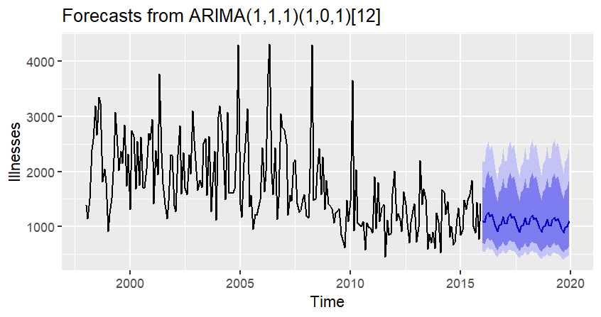
Forecast for ARIMA(1,1,1)x(1,0,1)12
Good performance for forecasting compared to actuals
Notes:
dat<-tsbox::ts_ts(tsbox::ts_long(df_outbreaks_summary %>% select(date,total_illnesses)))
fit<-forecast::Arima(dat,order=c(1,1,1),
seasonal=c(1,0,1),
lambda=0)
forecast_values <- forecast::forecast(fit,48)
forecast_values %>% autoplot(ylab=’Illnesses’)

Slide 34
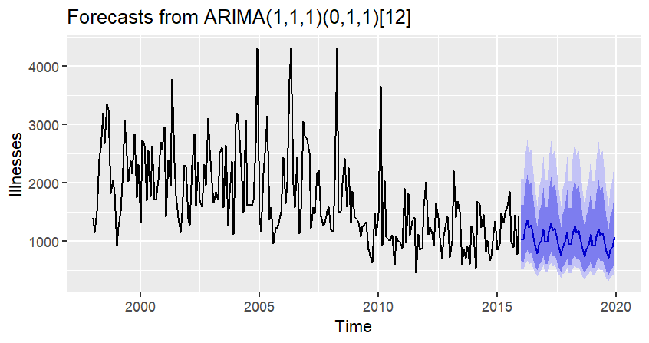
Forecast for ARIMA(1,1,1)x(0,1,1)12
This model appears to capture more of volatility
This model did not have a significant AR1 term
Notes:
ARIMA(1,1,1)x(0,1,1)₁₂ has smallest RMSE but AR1 term is not significant

Slide 35
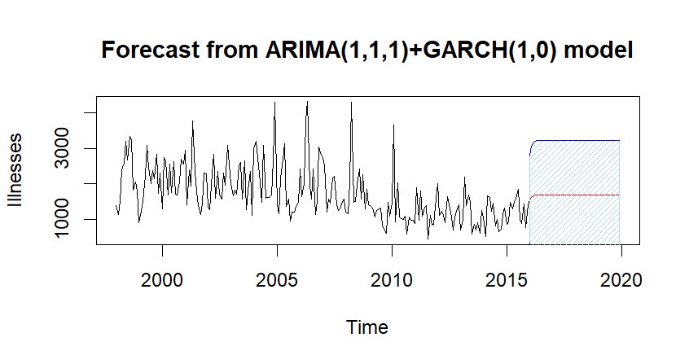
Forecast for ARIMA(1,1,1) + GARCH(1,0)
Like the non seasonal ARIMA models but the lower CI limit is 0
Similar pattern for forecasting using log data vs untransformed data
Notes:
custom output using exponentiated forecasts based on logged data

Slide 36
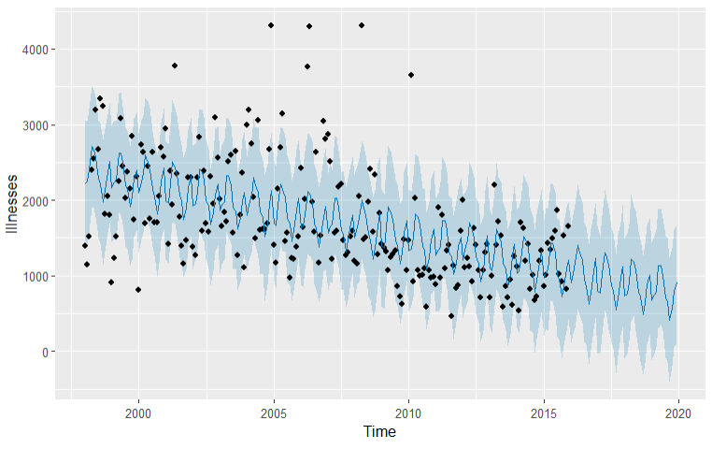
Forecast for Prophet
The model forecast appears to do a good job of capturing the seasonality of the historical data
The forecast also appears to have a slight negative trend

Slide 37
Forecasting Comparisons
Model | RMSE
ARIMA(1, 1, 1) | 489.42
ARIMA(1, 1, 0) | 474.94
ARIMA(1,1,1)x(1,0,1)₁₂ | 488.63
ARIMA(1,1,1)x(0,1,1)₁₂ | 487.91
ARIMA(1,1,1)-GARCH(1,0) | 552.43
Prophet | 638
Notes:
ARIMA(1,1,1)x(0,1,1)₁₂ has smallest RMSE but AR1 term is not significant

Slide 38
Data from 2016 and beyond
Data1: Foodborne illness data set (1998 - 2015):
https://www.kaggle.com/datasets/cdc/foodborne-diseases
Data2: National Outbreak Reporting System(1998 - 2020)
https://wwwn.cdc.gov/norsdashboard
Notes:
[Yuan] slides 38-46

Slide 39
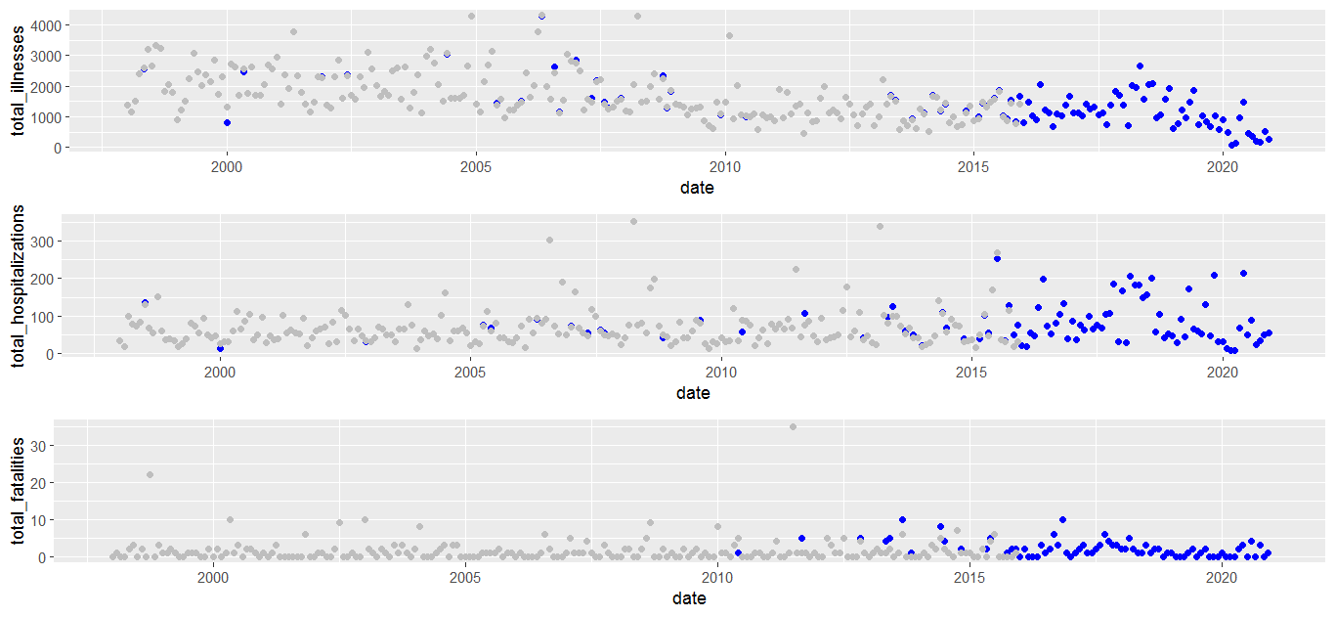
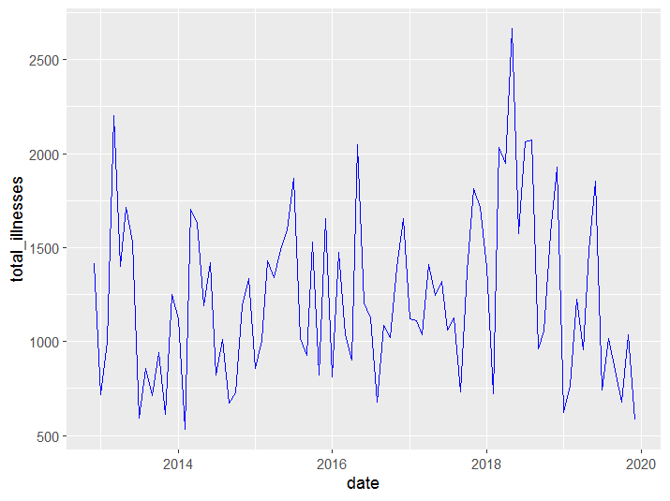
Validate 2016 and beyond data
2013 - 2020 illness from data 2
Choose 2016 - 2019(48 month)
For forecast comparing

Slide 40
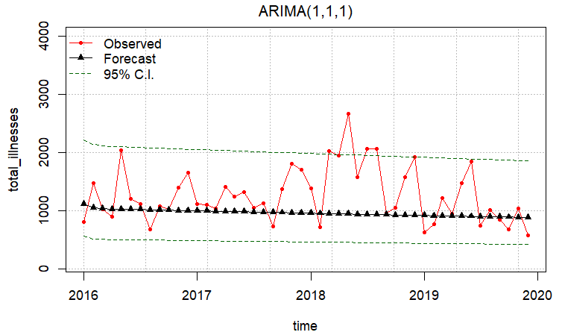
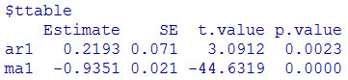
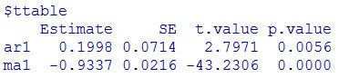
Real data and forecasting of ARIMA(1,1,1)
Model output from data before 2016 Forecast for data between 2016 - 2019
Data 1
Data 2

Slide 41
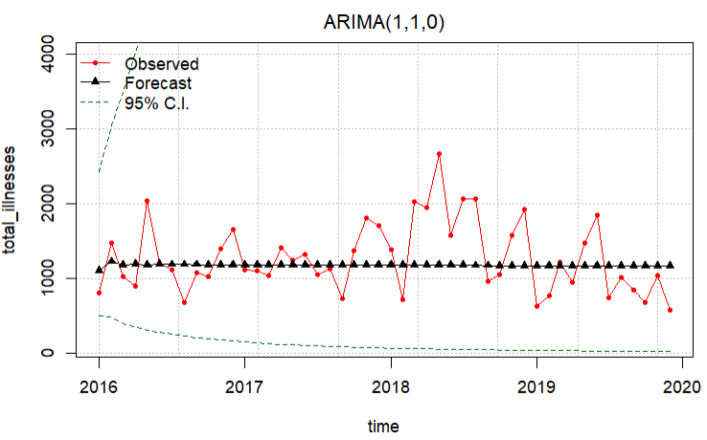
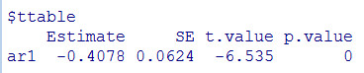
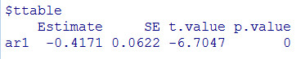
Real data and forecasting of ARIMA(1,1,0)
Model output from data before 2016 Forecast for data between 2016 - 2019
Data 1
Data 2

Slide 42
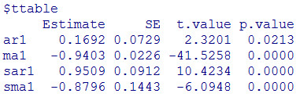
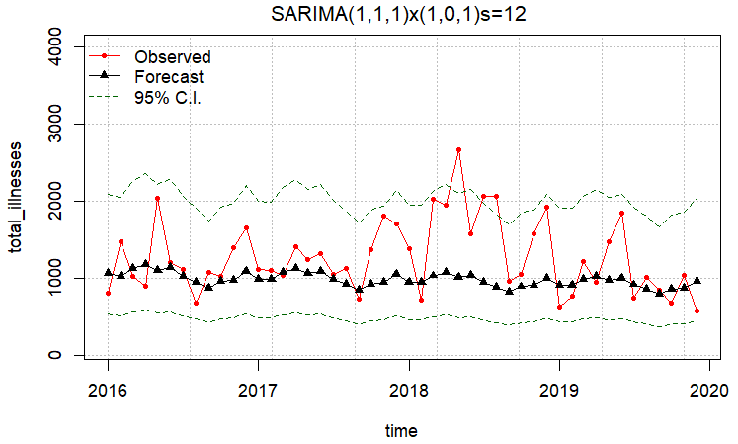
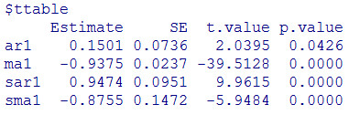
Real data and forecasting of SARIMA(1,1,1)x(1,0,1)₁₂
Model output from data before 2016 Forecast for data between 2016 - 2019
Data 1
Data 2

Slide 43
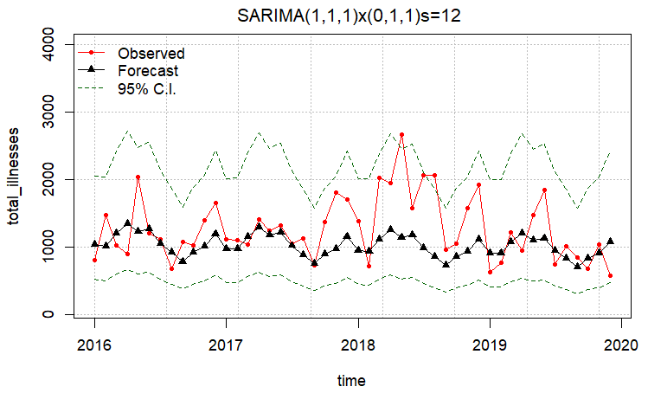
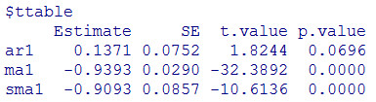

Real data and forecasting of SARIMA(1,1,1)x(0,1,1)₁₂
Model output from data before 2016 Forecast for data between 2016 - 2019
Data 1
Data 2

Slide 44



Real data and forecasting of ARIMA(1,1,1)-GARCH(1,0)
Model output from data before 2016 Forecast for data between 2016 - 2019
Data 1
Data 2

Slide 45


Real data and forecasting of Prophet Model
Fitting output from data before 2016 Forecast for data between 2016 - 2019

Slide 46
Conclusions
Notes:
[Trina] slides 47-end

Slide 47
Key takeaways
1. Model formulation and estimation. We constructed six models (two ARIMA, two SARIMA, ARIMA-GARCH, Prophet) and compared their fit and forecasts.
2. Model selection. We chose the ARIMA(1, 1, 1) x (1, 0, 1)₁₂ model, based on these criteria: - The seasonal ARIMA model has lower AIC and BIC values. - The forecast captures the seasonality of foodborne disease outbreaks better than non-seasonal models.
3. Validation. The RMSE of the forecast is the lowest of all models that include seasonality.

Slide 48
Learnings
Key Concepts:
Importance of the data
Time changes everything
Impact of the Data

Slide 49



Importance of Data
Data Cleaning
Source of the information
Understanding the basics of the project
Consumer habits
2022 - Sal - 572 (92 / 2) Backyard Poultry

Slide 50

Time Changes Everything
Regulatory Changes
Time Delays in Implementation
Improvements in Data Collection
Improvements in Testing

Slide 51

Outbreaks
1999 - Hot Dogs - LM - 100
2006 - Spinach - EC 205
2006 - Taco Bell - EC 71
2009 -Peanut Butter - SAL - 714
2011 - Canteloupes - LM 147
2011 -Ground Turkey - SAL - 136
2013 - Chicken - Sal - 634
2015 - Chipotle - EC - 55
2015 - Mexi Cucumbers - SAL - 907
2016 - Flour - EC 63
2017 - Leafy Greens - EC 25
2018 - Romaine - EC 272
2019 - Ground Beef - EC 209
2019 - Flour - EC 167

Slide 52


Impacts of the Data
Determines success of the industry
Basis for Regulatory Goals and Changes
Healthy People Goals - CDC
USDA / FDA Strategy
Regulatory Changes -
Sal Adulterant - Kiev / Cordon Blue
Flour Mills
Exclusion of Supply

Slide 53
Questions, comments, suggestions?

Slide 54
Thank you for your
engagement and feedback!

Slide 55

Surprisingly good of Prophet Model

